Slide 1
Real Estate Project
UCB Boot Camp
Team: Bharat, Gokul, Ritesh, Devang

Slide 2
Project : Real Estate Investment Tool
Project Description / Outline :
Real estate industry plays a significant role in driving the economy and development of the country and is also dependent on several external factors viz. – School ratings, Crime rate, Job employment rate, …
The purpose of this research is to create a tool that visualizes the average/mean sale price of houses in cities/counties and show how the housing prices are affected by other external factors.
Using this tool, you can visualize housing median sale price from past in conjunction with the external factors and also visualize it over Google maps.
All visualizations/maps are/can be download for later reference.

Slide 3
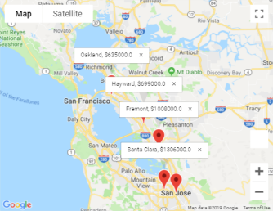
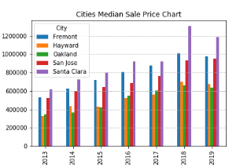
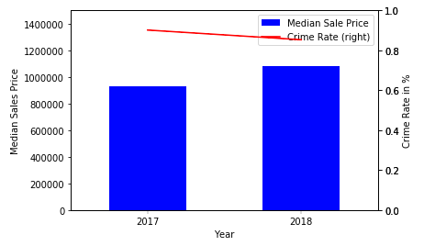
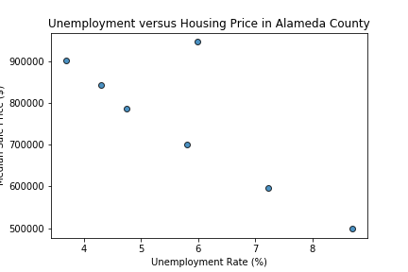
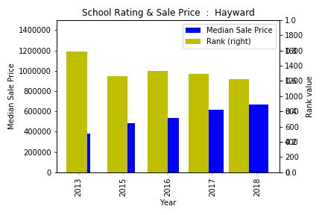
Project : Real Estate Investment Tool
Project Modules / flow :
Input
Input
Processing
OutPut
Processing
Output
Ritesh
School Ratings
City/County
Median sales data
School Raking
Crime Rate
Employment Rate
Bharat
Gokul
Visualizations
Input
Real Estate
Crime Rate
Devang
Employment Rate

Slide 4
Project : Real Estate Investment Tool – “Real Estate”
Real Estate Module Description:
This module gives insight and reliable data on the state of the housing market
Past 5~7 years data is used.
The output visualize the trends and shows/visualizes the same on maps
Here’s what’s used:
Cities – Fremont, San Jose, Santa Clara, Oakland, Hayward
Counties - San Francisco, Alameda, San Mateo, Napa, Santa Clara
Median sale price for past years
Here’s what’s the output:
Visualizations: Bar chart, Line graph, Scatter graph and Map visualizing markers for cities and counties showing the sale price
How it Works:
Output:
Input to other modules
House price Trend graphs
Google maps with markups
Clean up
Data collection
Parse data
Process data
Generate data for other modules
Input:
Real Estate Data.CSV

Slide 5
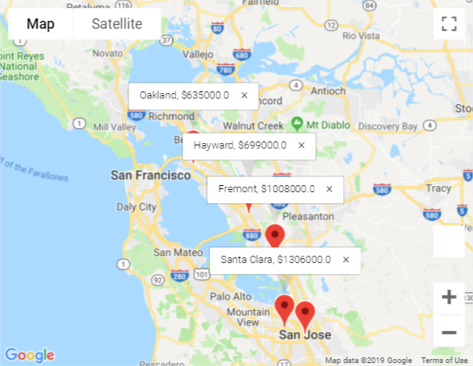
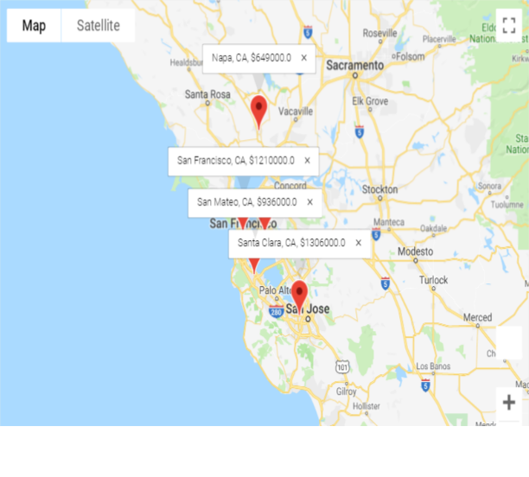
Project : Real Estate Investment Tool – “Real Estate”
Real Estate Module Output/Visualizations:
City – Median Sale Price
County – Median Sale Price
The visualization of the markups on Google maps with city name and median sale price of the city are created that gives a clear view on the housing price index for the cities/counties
These visualizations helps the end user to understand the areas with high/low real estate pricing on a broader aspect.
(this can be further enhanced to cover states, nation, )

Slide 6
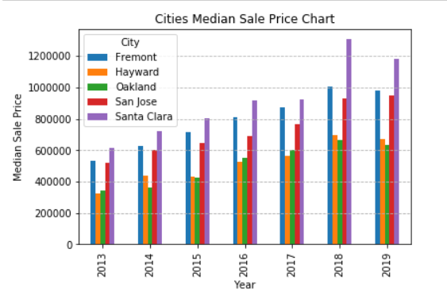
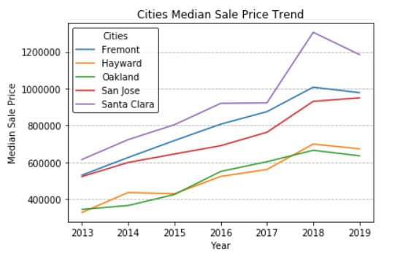
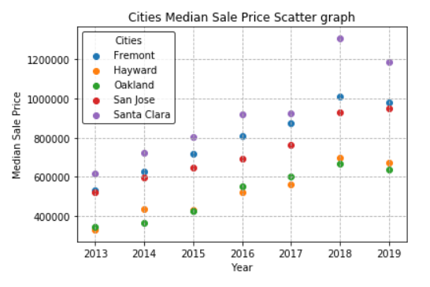
Project : Real Estate Investment Tool – “Real Estate”
Real Estate Module Output/Visualizations:
Median sale price for cities/counties is also visualized as:
Multi bar chart, depicting per year per city median sale price per city, mainly similar increase in pricing among cities.
Line trend chart, depicts the real estate price trend between cities across time, mainly an uptrend up until 2018, then in 2019, the price is falling.
Scatter chart, shows the relationship of real estate price between cities across time, showing the price variation among cities, in some years the price difference in not much between these cities.
With the help of these visualizations end user will have enough details to understand the real estate price index.
These visualization also give clear comparable visuals among different cities or different counties which further helps end user to decide on future investment.
(can be enhanced to cover across state, nation).

Slide 7
Project : Real Estate Investment Tool – “School Rating”
School Rating Module Description:
This module gives insight and most reliable data on the state of the housing market. Using the tools you can visualize and download housing market data for metropolitan areas, cities and counties across CA.
Here’s what’s available:
School ratings for all Schools for past 5 past years
The School ratings is available for all schools in the cities of selected 3 counties
Average Sale price of all house for major cities in past 5 yrs from other module
How it Works:
We selected a set of 5 sample cities across 3 major counties and picked the school rating for the ‘High Schools’ in those cities
We calculated the School rating for city by calculating the mean of rating of all the High schools in the city and joined the results with the Mean Sales price for the same sample cities
Visualize for each city over 5 yrs – plotted the Sale prices and School rating over 6 yr period
Visualization of School ratings for the 5 cities over a period of 5 yrs

Slide 8
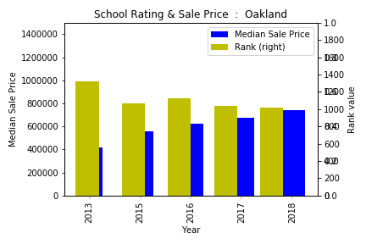
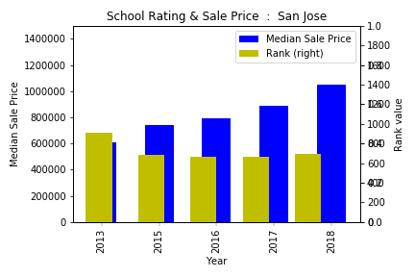
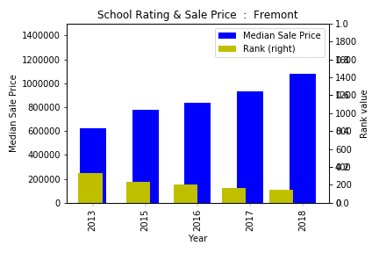
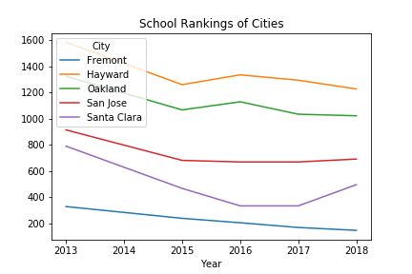
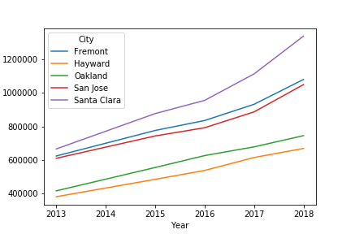
Project : Real Estate Investment Tool – “School Rating”
School Rating Module Output/Visualizations:
Observations :
Year over Year as the School Rank improved(decreased) the mean sale prices have gone higher
The better(lower) the school ranking value the higher the Sale price if we compare 2 cities like Hayward vs Fremont
We also observe that few cities have very high number of Highschools (>5) wheras most others very low (<=2) so using Mean of Rating is not a very good way to gauge all the schools
Identifying city with good school rating but lower Selling price could be a good investment opportunity

Slide 9
Project : Real Estate Investment Tool – “Crime Rate”
Crime Rate Module Description:
The decisions of buyers on the housing market are not only the sum of their subjective expectations but also of the perception of real estate through a prism of opinions and suggestions arising from the surroundings. One of the basic criteria driving households determined to meet basic housing needs is security. The aim of the study is to identify the relationship between the transaction prices of housing and the crime rate in the various districts of Szczecin. For this purpose, data from the California are analyzed in the work.
How it Works:
Inputs: Crime data CSV file and merged with Output CSV file from Real Estate Module
For the list of Cities in the file from the Real Estate Module – visualize the Crime and its impact to Real Estate (Median Sales Price)
Dual Axis Graph for each city (With a Bar Graph for Medial Sales Price and Line Graph for Crime Data over years)
Bar Graphs for the years 2017 and 2018 displaying the Crime Rate for the Cities selected
Each visualization will display data for the number of cities available in the Real Estate Module. The visualization are displayed. The user can download the map visualization and/or will get the visualization copied/stored as .png file.

Slide 10
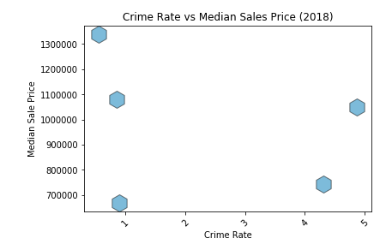
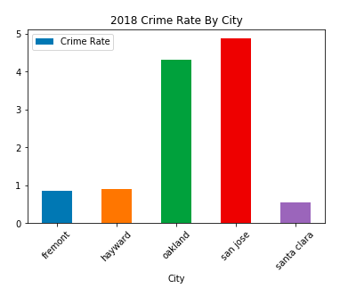
Project : Real Estate Investment Tool – “Crime Rate”
Crime Data Output/Visualizations:
Dual Axis Graph

Slide 11
Project : Real Estate Investment Tool – “Employment Rate”
Employment Statistics Module Description:
This module gives insight and most reliable data on the state of the housing market. Using the tools you can visualize and download housing market data for metropolitan areas, cities and counties across CA.
Here’s what’s available:
Unemployment rates for all California counties from 2009 to 2018 for all counties
The unemployment rate for 5 selected counties was chosen for analysis
Median sale price of homes in the selected 5 counties from 2012 to 2018
How it Works:
We selected a set of 5 counties and found the unemployment rates across every month in the selected year.
We took the mean of the unemployment rates for every month of the year to obtain a rating for the entire year for each county.
3. Plotted how the unemployment rate changed over each year for every county.
4. Plotted how the unemployment rate related to the median sales price for each county.

Slide 12
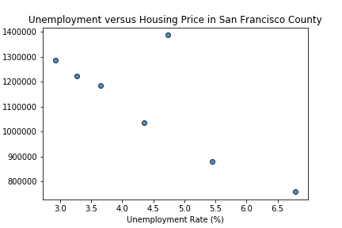
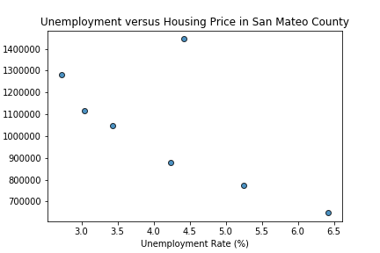
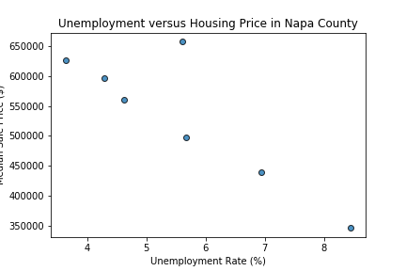
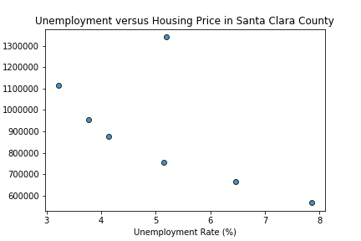
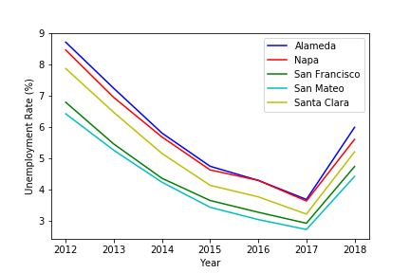
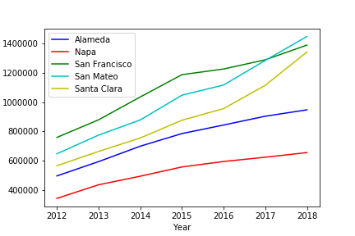
Project : Real Estate Investment Tool – “Employment Rate”
Employment Module Output/Visualizations:
Observations :
A very similar pattern was seen in each county.
As unemployment increased, house prices tended to
decrease. 2018 was an exception – house prices peaked despite relatively low unemployment. This sudden reversal of the previous trend suggests that unemployment rates may not necessarily be an accurate predictor of housing prices.

Slide 13
Project : Real Estate Investment Tool – “References”
Geocode api: to fetch latitude/longitude
Geomap api: to visualize real estate data
Real Estate Data: https://www.redfin.com/blog/data-center
School rating/ranking Data: https://developer.schooldigger.com
Crime Data: https://www.ucrdatatool.gov/Search/Crime/State/StatebyState.cfm
Employment Rate Statistics: https://dev.socrata.com/foundry/data.edd.ca.gov/e6gw-gvii

